Slide 1
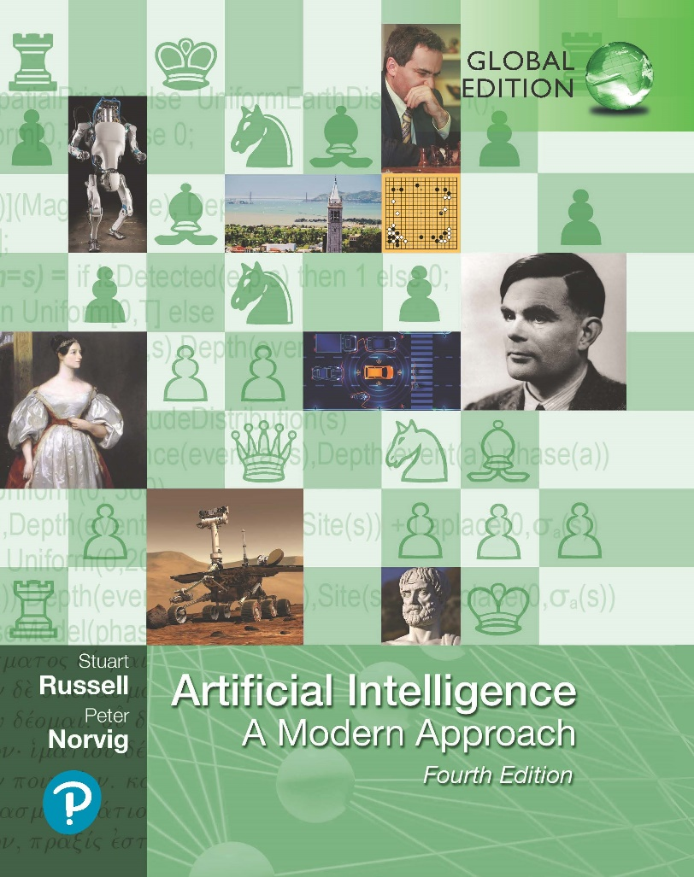
Artificial Intelligence: A Modern Approach
Fourth Edition, Global Edition
Chapter 16
Making Complex Decisions
© 2022 Pearson Education Ltd.

Slide 2
Outline
Sequential Decision Problems
Basic Probability Notation
Bandit Problems
Partially Observable MDPs
Algorithms for Solving POMDPs
© 2022 Pearson Education Ltd.

Slide 3
Sequential Decision Problems
Markov decision process (MDP): a sequential decision problem for a fully observable, stochastic environment
MDP consists of:
a set of states (with an initial state s₀);
a set ACTIONS(s) of actions in each state;
a transition model P(s | s, a); and
a reward function R(s, a, s ). Methods for
MDP solutions usually involve dynamic programming simplifying a problem by recursively breaking it into smaller pieces and remembering the optimal solutions to the pieces.
A solution called policy.
specify what the agent should do for any state that the agent might reach
the quality of a policy is measured by the expected utility of possible environment histories generated
optimal policy: highest expected utility
© 2022 Pearson Education Ltd.

Slide 4
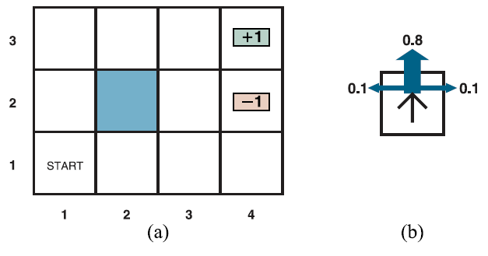
Sequential Decision Problems
a) A simple, stochastic 43 environment that presents the agent with a sequential
decision problem.
(b) Illustration of the transition model of the environment: the “intended” outcome occurs with probability 0.8, but with probability 0.2 the agent moves at right angles to the intended direction. A collision with a wall results in no movement. Transitions into the two terminal states have reward +1 and –1, respectively, and all other transitions have a reward of –0.04.
© 2022 Pearson Education Ltd.

Slide 5
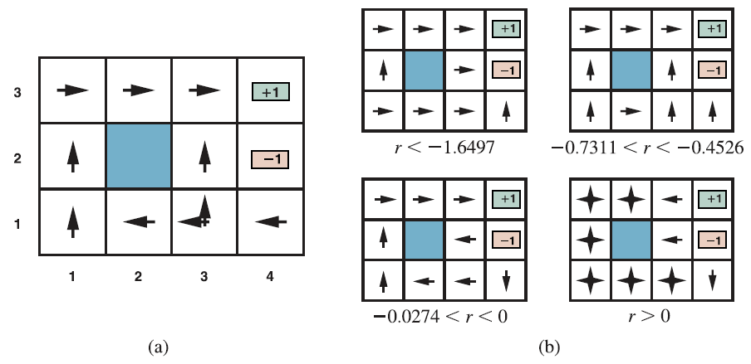
Sequential Decision Problems
Utilities over time
Not only possibility for the utility function on environment histories
Utilities: U_{h}([s₀, a₀, s₁, a₁ . . . , s_{n}]).
(a) The optimal policies for the stochastic environment with r = 0.04 for transitions between nonterminal states. There are two policies because in state (3,1) both Left and Up are optimal. (b) Optimal policies for four different ranges of r.
© 2022 Pearson Education Ltd.

Slide 6
Sequential Decision Problems
Finite horizon: fixed time N after which nothing matters
Uh([s₀, a₀, s₁, a₁, . . . , sN₊k]) = Uh([s₀, a₀, s₁, a₁, . . . , sN])
optimal action in a given state may depend on how much time is left
Nonstationary: A policy that depends on the time
infinite horizon: no fixed time limit
there is no reason to behave differently in the same state at different times.
Optimal action depends only on the current state, and the optimal policy is stationary.
© 2022 Pearson Education Ltd.

Slide 7

Sequential Decision Problems
Additive discounted rewards:
U_{h}([s₀, a₀, s₁, a₁, s₂, . . .]) = R(s₀, a₀, s₁) + γR(s₁, a₁, s₂) + γ²R(s₂, a₂, s₃) + · · · ,
where the discount factor γ is a number between 0 and 1.
γ close to 0, not willing wait
γ close to 1, willing wait long term reward
Additive discounted rewards makes sense: empirical, economical, uncertainty about true rewards, preferences over histories.
Reduces complexity of infinite sequence due to utility is finite.
if γ < 1 and rewards are bounded by ±R_{max}, we have
Proper policy: guaranteed to reach a terminal state
Infinite sequences can be compared in terms of the average reward obtained per time
© 2022 Pearson Education Ltd.

Slide 8




Sequential Decision Problems
Utility of a state is the expected reward for the next transition plus the discounted utility of the next state, assuming that the agent chooses the optimal action
This is called the Bellman equation, after Richard Bellman (1957).
Action-utility function, or Q-function: Q(s, a)
the expected utility of taking a given action in a given state.
related to utilities in the obvious way:
The optimal policy can be extracted from the Q-function
The Q-function is in algorithms for solving MDPs
© 2022 Pearson Education Ltd.

Slide 9
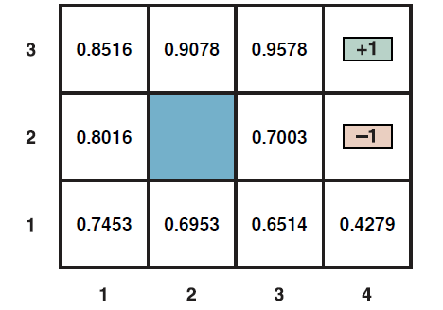
Sequential Decision Problems
The utilities of the states in the 4 3 world with γ = 1 and r = 0.04 for transitions to nonterminal states.
The expression for U (1, 1) is
max{ [0.8(−0.04 + γU (1, 2)) + 0.1(−0.04 + γU (2, 1)) +0.1(−0.04 + γU (1, 1))],
[0.9(−0.04 + γU (1, 1)) + 0.1(−0.04 + γU (1, 2))],
[0.9(−0.04 + γU (1, 1)) + 0.1(−0.04 + γU (2, 1))],
[0.8(−0.04 + γU (2, 1)) + 0.1(−0.04 + γU (1, 2)) + 0.1(−0.04 + γU (1, 1))]}
© 2022 Pearson Education Ltd.

Slide 10

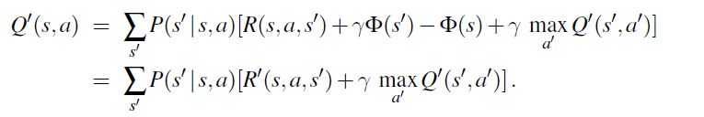
Reward scales
Transformation of rewards will leave the optimal policy unchanged in an MDP:
R (s, a, s ) = mR(s, a, s ) + b.
Extract the optimal policy for M!
The function Φ(s) is often called a potential,
if Φ(s) has higher value in states that have higher utility, the addition of
γΦ(s^{t}) − Φ(s) to the reward has the effect of leading the agent “uphill” in utility.
© 2022 Pearson Education Ltd.

Slide 11
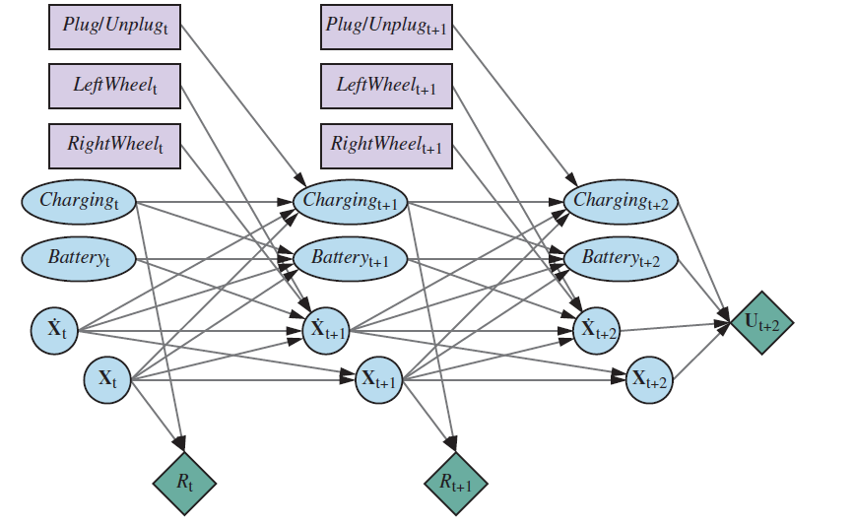
Representing MDPs
Dynamic decision networks, or DDNs are factored representations
.
A dynamic decision network for a mobile robot with state variables for battery level, charging status, location, and velocity, and action variables for the left and right wheel motors and for charging.
© 2022 Pearson Education Ltd.

Slide 12
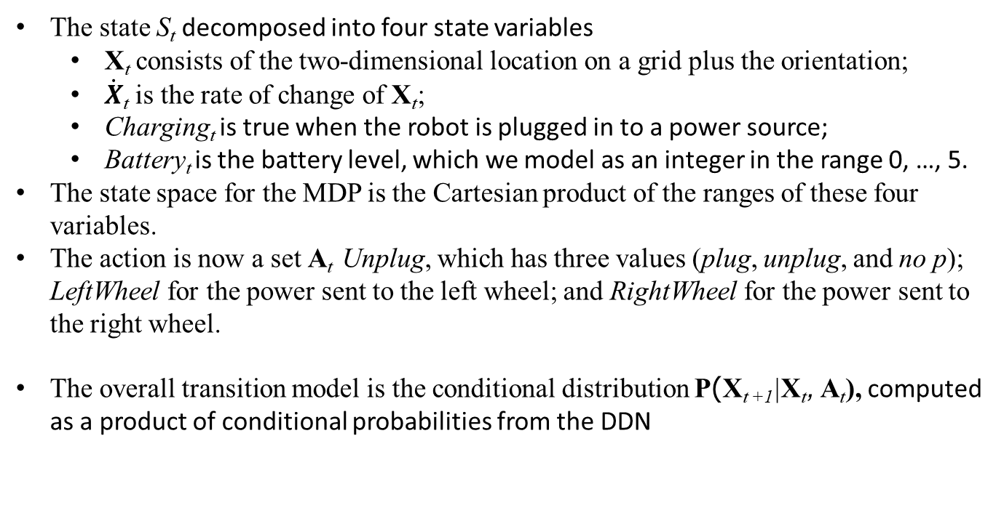
Representing MDPs
The state S_{t} decomposed into four state variables
X_{t} consists of the two-dimensional location on a grid plus the orientation;
$\dot{X}$_{t} is the rate of change of X_{t};
Charging_{t} is true when the robot is plugged in to a power source;
Battery_{t} is the battery level, which we model as an integer in the range 0, …, 5.
The state space for the MDP is the Cartesian product of the ranges of these four variables.
The action is now a set A_{t} Unplug, which has three values (plug, unplug, and no p); LeftWheel for the power sent to the left wheel; and RightWheel for the power sent to the right wheel.
The overall transition model is the conditional distribution P(X_{t +1}|X_{t}, A_{t}), computed as a product of conditional probabilities from the DDN
© 2022 Pearson Education Ltd.

Slide 13
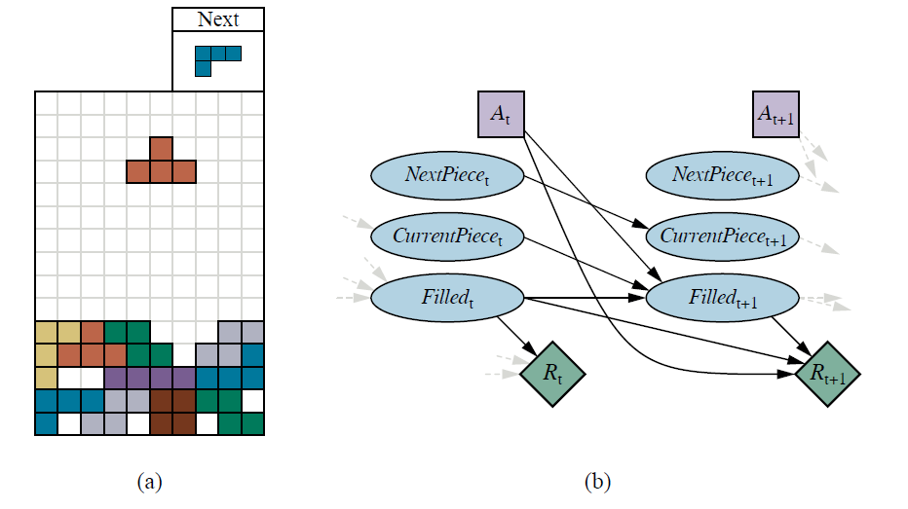
Representing MDPs
The game of Tetris. The T-shaped piece at the top center can be dropped in any orientation and in any horizontal position. If a row is completed, that row disappears and the rows above it move down, and the agent receives one point. The next piece (here, the L-shaped piece at top right) becomes the current piece, and a new next piece appears, chosen at random from the seven piece types. The game ends if the board fills up to the top.
The DDN for the Tetris MDP.
© 2022 Pearson Education Ltd.

Slide 14

Algorithms for MDPs (Value Iteration)
Value Iteration
The Bellman equation is the basis of the value iteration
If there are n possible states, then there are n Bellman equations,
The n equations contain n unknowns—the utilities of the states.
The equations are nonlinear, because the “max” operator is not a linear operator.
start with arbitrary initial values for the utilities, calculate the right-hand side of the equation, and plug it into the left-hand side—thereby updating the utility of each state from the utilities of its neighbors.
Repeat this until reach an equilibrium.
The iteration step, called a Bellman update, looks like this
update is assumed to be applied simultaneously to all the states at each iteration
© 2022 Pearson Education Ltd.

Slide 15
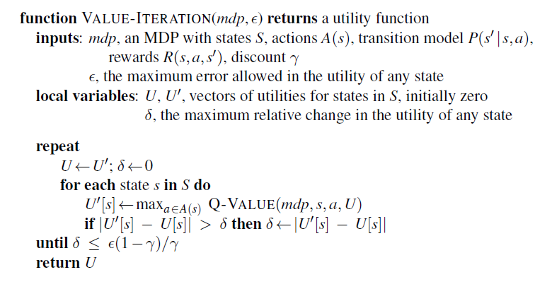
Algorithms for MDPs (Value Iteration)
The value iteration algorithm for calculating utilities of states.
© 2022 Pearson Education Ltd.

Slide 16
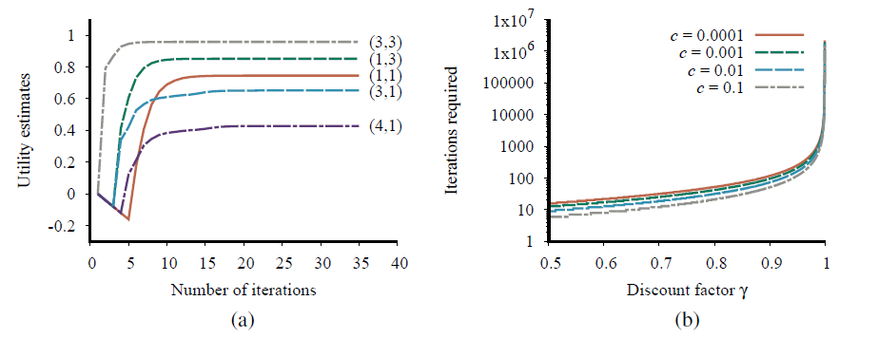
Algorithms for MDPs (Value Iteration)
Value Iteration applied to 4 x 3 world
Graph showing the evolution of the utilities of selected states using value iteration.
The number of value iterations required to guarantee an error of at most E = c R_{max} for different values of c, as a function of the discount factor γ.
© 2022 Pearson Education Ltd.

Slide 17


Algorithms for MDPs (Policy Iteration)
Policy Iteration
Alternates the following two steps beginning from some initial policy π₀:
Policy evaluation: given a policy π_{i}, calculate U_{i} =U ^{π}i , the utility of each state if π_{i} were to be executed.
Policy improvement: Calculate a new MEU policy π_{i+1}, using one-step look-ahead based on U_{i}
The algorithm terminates when the policy improvement step yields no change in the utilities.’
Action in each state is fixed by the policy. At the ith iteration, the policy π_{i} specifies the action π_{i}(s) in state s.
Simplified version of the Bellman equation relating the utility of s (under π_{i}) to the utilities of its neighbors:
For large state spaces, time is prohibitive. Simplified Bellman update modified policy iteration
© 2022 Pearson Education Ltd.

Slide 18
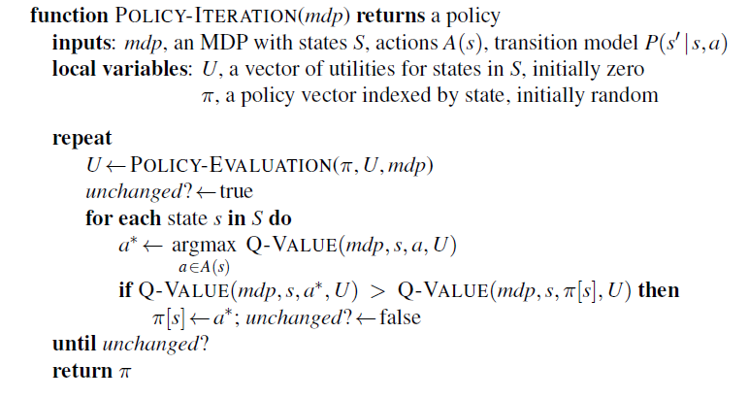
Algorithms for MDPs (Policy Iteration)
The policy iteration algorithm for calculating an optimal policy.
© 2022 Pearson Education Ltd.

Slide 19

Algorithms for MDPs (Linear programming)
Linear programming (LP)
General approach for formulating constrained optimization problems
Minimize U(s) for all s subject to the inequalities for every state s and every action a.
In practice, it turns out that LP solvers are seldom as efficient as dynamic programming for solving MDPs.
linear programming is solvable in polynomial time polynomial however the number of states is often very large.
© 2022 Pearson Education Ltd.

Slide 20
Algorithms for MDPs (Online algorithms)
Online Algorithms
EXPECTIMAX algorithm builds a tree of alternating max and chance nodes
An evaluation function can be applied to the nonterminal leaves of the tree, or they can be given a default value.
A decision can be extracted from the search tree by backing up the utility values from the leaves, taking an average at the chance nodes and taking the maximum at the decision nodes.
The explored states actually constitute a sub-MDP of the original MDP, and this sub-MDP can be solved using any of the algorithms in this chapter.
This approach is called real-time dynamic programming (RTDP)
© 2022 Pearson Education Ltd.

Slide 21
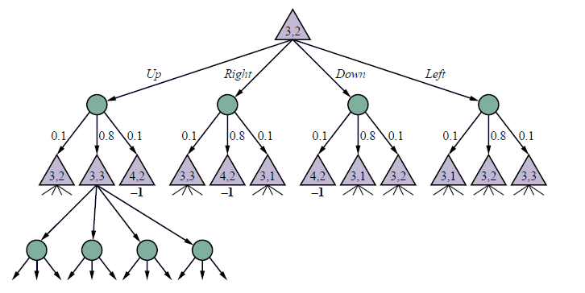
Algorithms for MDPs (Online algorithms)
Part of an expectimax tree for the 43 MDP rooted at (3,2). The triangular nodes are max modes and the circular nodes are chance nodes.
© 2022 Pearson Education Ltd.

Slide 22
Bandit Problems
In Las Vegas, a one-armed bandit is a slot machine.
An n-armed bandit has n levers.
Behind each lever is a fixed but unknown probability distribution of winnings.
The gambler must choose which lever to play on each successive coin
Tradeoff between exploitation of the current best action to obtain rewards and exploration of previously unknown states and actions to gain information
Formal model for real problems important areas, such as
deciding which of n possible new treatments to try to cure a disease,
which of n possible investments to put part of your savings into,
which of n possible research projects to fund
© 2022 Pearson Education Ltd.

Slide 23
Bandit Problems
Bandit problems definitions
“Each arm M_{i} is a Markov reward process or MRP, that is, an MDP with only one possible action a_{i}. It has states S_{i}, transition model P_{i}(s^{t} s, a_{i}), and reward R_{i}(s, a_{i}, s^{t}). The arm defines a distribution over sequences of rewards R_{i,0}, R_{i,1}, R_{i,2}, . . ., where each R_{i,t} is a random variable.”
“The overall bandit problem is an MDP: the state space is given by the Cartesian product S = S₁ S_{n}; the actions are a₁, . . . , a_{n}; the transition model updates the state of whichever arm M_{i} is selected, according to its specific transition model, leaving the other arms unchanged; and the discount factor is γ.”
The key property is that the arms are independent, only one arm can work at a time.
© 2022 Pearson Education Ltd.

Slide 24
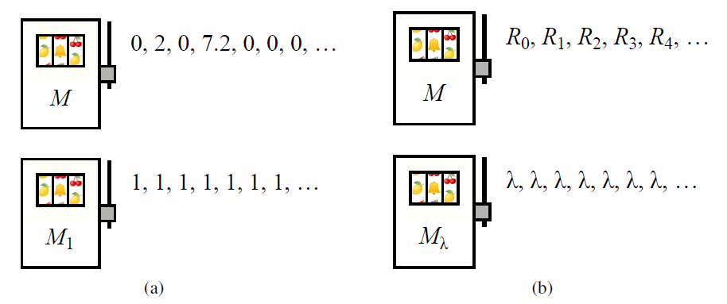
Bandit Problems
A simple deterministic bandit problem with two arms. The arms can be pulled in any order, and each yields the sequence of rewards shown.
A more general case of the bandit in (a), where the first arm gives an arbitrary sequence of rewards and the second arm gives a fixed reward λ.
© 2022 Pearson Education Ltd.

Slide 25
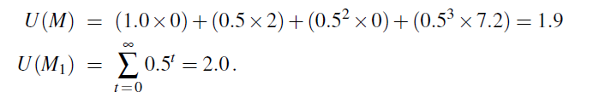
Bandit Problems
Computing the utility (total discounted reward) for each arm:
Starting with M and then switching to M after the fourth reward gives the sequence S = 0, 2, 0, 7.2, 1, 1, 1, . . ., for which
The strategy S that switches from M to M1 at the right time is better than either arm individually
© 2022 Pearson Education Ltd.

Slide 26

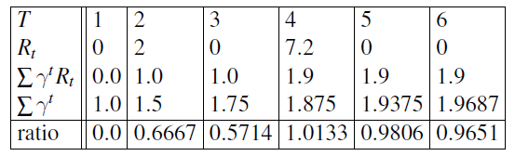
Bandit Problems
Optimal strategy is to run arm M up to time T and then switch to M_{λ} for the rest of time.
Gittins Index:
value describes the maximum obtainable utility per unit of discounted time.
© 2022 Pearson Education Ltd.

Slide 27
Bandit Problems
The Bernoulli bandit
simplest and best-known instance of a bandit problem
where each arm M_{i} produces a reward of 0 or 1 with a fixed but unknown probability µ_{i}.
The state of arm M_{i} is defined by s_{i} and f_{i}, the counts of successes (1s) and failures (0s) so far for that arm;
the transition probability predicts the next outcome to be 1 with probability (s_{i})/(s_{i} + f_{i}) and 0 with probability ( f_{i})/(s_{i} + f_{i}).
The counts are initialized to 1 so that the initial probabilities are 1/2 rather than 0 .
© 2022 Pearson Education Ltd.

Slide 28
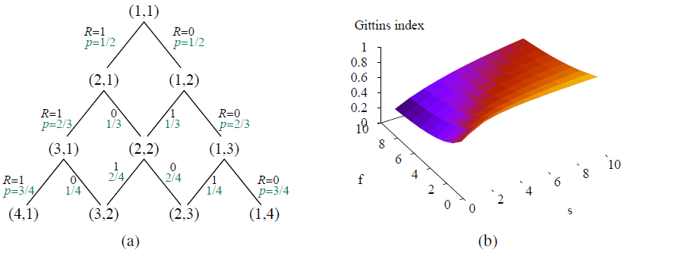
Bandit Problems
The Bernoulli bandit
States, rewards, and transition probabilities for the Bernoulli bandit.
Gittins indices for the states of the Bernoulli bandit process.
© 2022 Pearson Education Ltd.

Slide 29
Partially Observable MDPs
Partially observable MDPs (POMDPs)
MDPs [the transition model P(s^{t} s, a), actions A(s), and reward function R(s, a, s^{t})]
POMDPs are MDPs with sensor model P(e|s).
Obtain compact representations for large POMDPs by using dynamic decision networks
We add sensor variables E_{t}, assuming that the state variables X_{t} may not be directly observable.
Thus the sensor model is P(E_{t}|X_{t}).
Steps of decision cycle of a POMDP agent
Given the current belief state b, execute the action a = π∗(b).
Observe the percept e.
Set the current belief state to FORWARD(b, a, e) and repeat.
© 2022 Pearson Education Ltd.

Slide 30
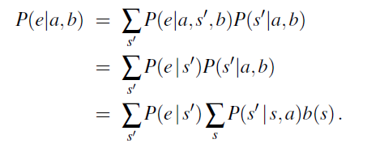
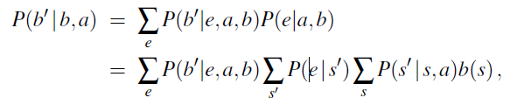

Partially Observable MDPs
P(b^{t} |b, a) and ρ(b, a) define an observable MDP on the space of belief states.
© 2022 Pearson Education Ltd.

Slide 31
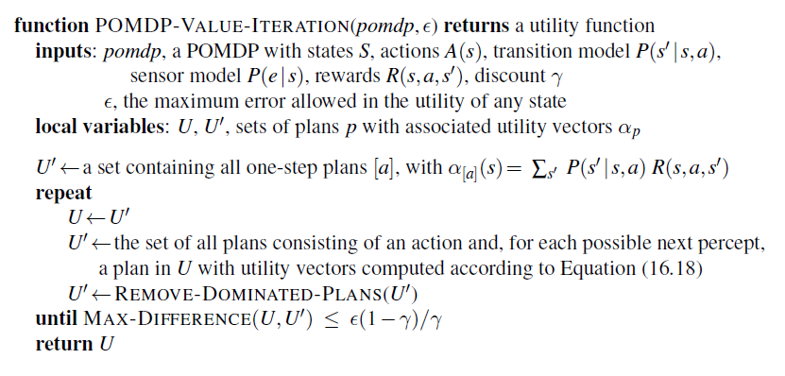
Algorithms for Solving POMDPs
Value iteration for POMDPs
A high-level sketch of the value iteration algorithm for POMDPs. The REMOVE-DOMINATED-PLANS step and MAX-DIFFERENCE test are typically implemented as linear programs.
© 2022 Pearson Education Ltd.

Slide 32
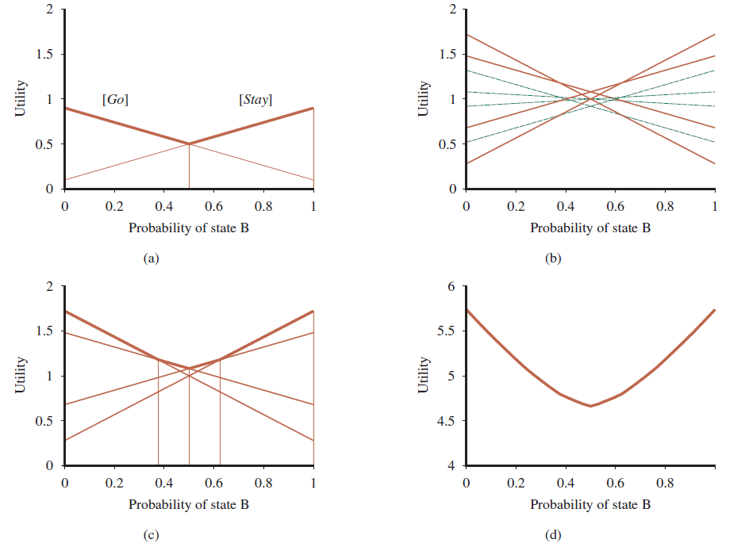
Algorithms for Solving POMDPs
(a) Utility of two one-step plans as a function of the initial belief state b(B) for the two-state world, with the corresponding utility function shown in bold. (b) Utilities for 8 distinct two-step plans. (c) Utilities for four undominated two-step plans. (d) Utility function for optimal eight-step plans.
© 2022 Pearson Education Ltd.

Slide 33
Algorithms for Solving POMDPs
Online algorithms for POMDPs
Starts with some prior belief state;
It chooses an action based on some deliberation process centered on its current belief state;
After acting, it receives an observation and updates its belief state using a filtering
Algorithm; and the process repeats.
Excpectimax algorithm (belief states rather than physical states as decision nodes)
The chance nodes in the POMDP tree have branches labeled by possible observations and leading to the next belief state, with transition probabilities
The combination of particle filtering and UCT applied to POMDPs goes under the name of partially observable Monte Carlo planning or POMCP.
© 2022 Pearson Education Ltd.

Slide 34
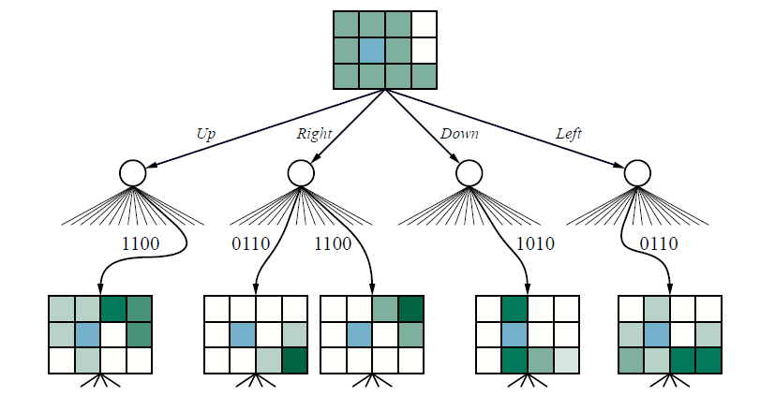
Algorithms for Solving POMDPs
Part of an expectimax tree for the 43 POMDP with a uniform initial belief state.
The belief states are depicted with shading proportional to the probability of being in each location.
© 2022 Pearson Education Ltd.

Slide 35
Summary
Sequential decision problems in stochastic environments, also called Markov decision processes, or MDPs, are defined by a transition model
The solution of an MDP is a policy that associates a decision
with every state that the agent might reach.
The value iteration algorithm iteratively solves a set of equations
relating the utility of each state to those of its neighbors
Policy iteration alternates between calculating the utilities of states under the current
Partially observable MDPs, or POMDPs, are much more difficult to solve than are
MDPs.
© 2022 Pearson Education Ltd.

